Slide 1

SUMMIT
Infrastructure of the Future
November 1, 2023

Slide 2
Study Group Participants
Alan LaFave, co-chair
Becky Collins, BSC
Carol Flaa, BSC
Mile Ellingson, Director of Facilities, NDSU
Mike Pieper, AVP for facilities, UND
Joe Tykwinski, CIO, VCSU
Jessica Gortmaker, Director of Facilities, VCSU
Darin King, Vice Chancellor, NDUS
Rick Tonder, Director of Facilities Planning, NDUS
Dr. Mark Hagerott, NDUS Chancellor, ex-officio
Jerry Rostad, NDUS Vice Chancellor, ex-officio
John Warford, co-chair
DeAnna Zink, Foundation CEO, UND
Jason Fincel, NDSA president (NDSU)
Jace Beehler, Chief of Staff, Governor’s office
Rep. Steve Swiontek, ND State Representative
Kuldip Mohanty, CIO, NDIT (his EA Raulie Berthold)

Slide 3
Infrastructure of the Future
IT Infrastructure Physical Infrastructure

Slide 4
IT Infrastructure
Ensuring information technology infrastructure is ready to meet the needs of students, teachers and the workforce
Determine kind of infrastructure necessary to support the delivery of education
Centralized or fragmented IT infrastructure decisions
IT flexibility to meet various learning modalities

Slide 5
IT TOPIC: Working Together METHODOLOGY
Full committee discussion
Sub-committee discussion
Sub-committee report/recommendation

Slide 6
IT TOPIC: Working Together RECOMENDATION: CONTINUE TO DEVELOP
Continue to refine and develop the capacity and capabilities of the NDUS systemwide Security Operations Center.
Continue to collaborate with the North Dakota Information Technology Department to:
continually improve the capabilities and resilience of the state network.
continually improve the security posture of the state.
Increase the pace of the migration to cloud services with the intent of reducing the size/scope/need/expense of local data centers.

Slide 7
IT TOPIC: Effective Planning CALL TO ACTION
Ensure IT infrastructure is part of the institutional 10-year facilities master plan.
As federal broadband funding expands fiber optics statewide, ensure all campuses have multiple, path diverse fiber connections to the state network.
Align with the changing higher educational landscape to support online, on campus, and blended courses using advanced technologies.
Develop a plan to leverage technology to improve the physical security of campuses.
Support for a new Enterprise Resource Planning system (Finance, Human Resources, Student Information) that will support improved capabilities and options for individual institution specific configurations.

Slide 8
IT TOPIC: Data and Information Intelligence CALL TO ACTION
Support to leverage Artificial Intelligence and Machine Learning to support students and develop more efficient services.
Support to improve data governance, data mart development, and overall data intelligence capabilities significantly and rapidly for all NDUS institutions.
Support for replacements and upgrades to systems that are conducive to data sharing and AI capabilities.

Slide 9
Overlapping IT and Physical Infrastructure Topics
Information Technology Infrastructure and Physical Infrastructure overlap in multiple areas.
Ten-year plan includes various overlapping parts
Deferred maintenance
Consolidation of services
Technology incorporation into physical spaces

Slide 10
Physical Infrastructure
Continuous monitoring of physical infrastructure as it relates to the needs of each institution based on their ever-changing number of students, staff and faculty
Safe spaces for students, employees and the public
Utilization of campus master plans
Building maintenance
Preservation of historic spaces

Slide 11
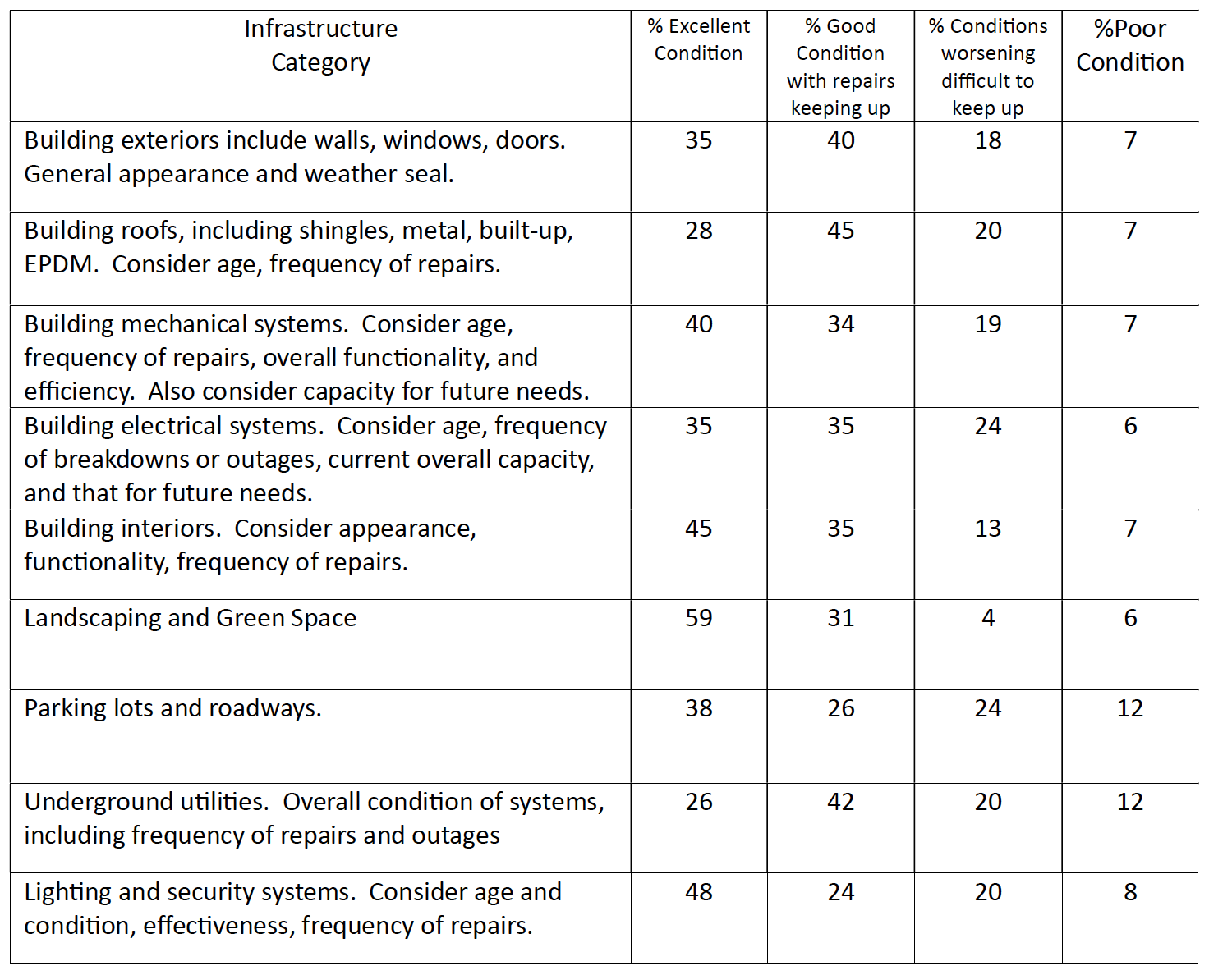
TOPIC: Physical Infrastructure METHODOLOGY
Questionnaire results from all campuses

Slide 12
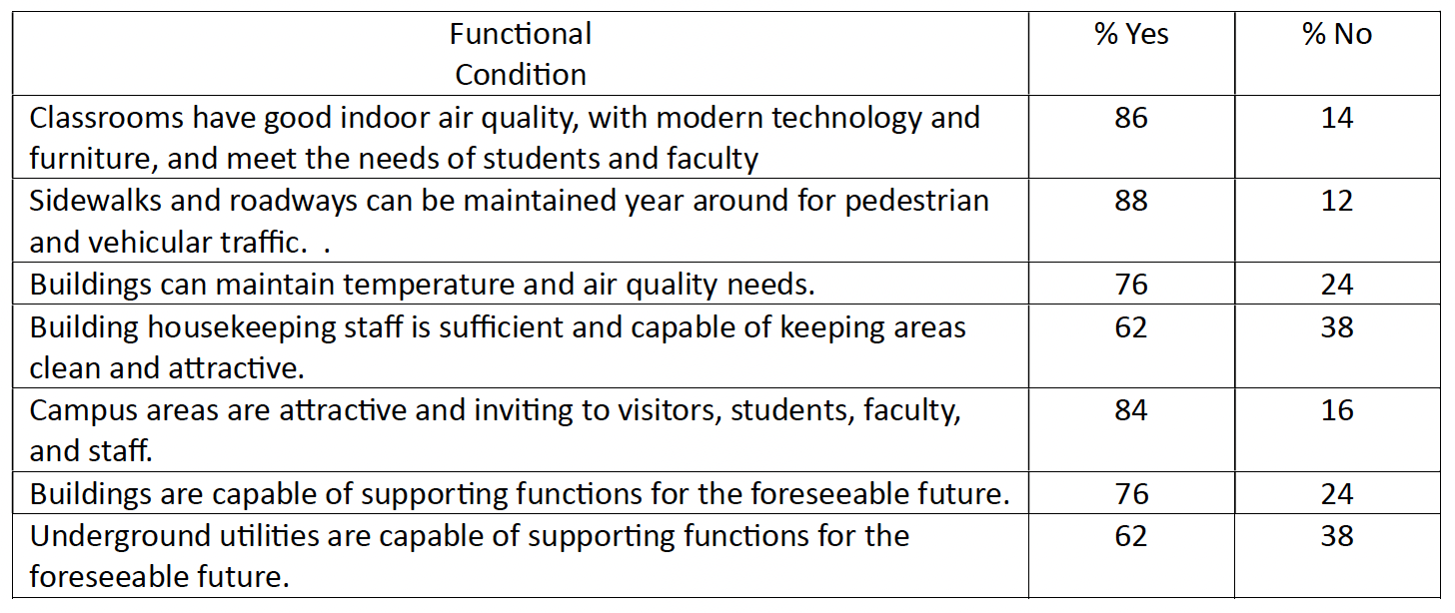
TOPIC: Physical Infrastructure METHODOLOGY
Campus buildings (all types and uses) total SF: 16,793,214 square feet

Slide 13
PHYSICAL INFRASTRUCTURE TOPIC: Deferred maintenance CALL TO ACTION
Current funding levels for maintenance remain inadequate to halt or even slow the growing deferred maintenance liability. Creation of the Capital Building fund has helped, but the needs still greatly outweigh the resources.
Building envelope repairs remain a priority, but as a result many other needs are left unattended. Modernization of building envelope systems (windows, roofs, doors, etc.) should be undertaken whenever possible to reduce energy consumption.
The North Dakota climate greatly accelerates the decay of parking lots, roadways, and sidewalks. Concrete replacements should be specified whenever possible.
Many mechanical and electrical systems open run to failure, then repaired on an emergency basis.

Slide 14
PHYSICAL INFRASTRUCTURE TOPIC: Human Capital CALL TO ACTION
Custodial and maintenance staff positions are left unfilled, which in turn exacerbates the deferred maintenance problems. There does not appear to be relief for this condition on the horizon.
Facility administration positions are difficult to fill and are routinely hired away by school districts and other entities that can pay higher salaries.

Slide 15
Future Committee Work
Literature Reviews
Identify best practices for both IT and Physical infrastructure
Capital Project prioritization process
Consolidation of services
Embedding of IT Infrastructure into campus master plans

Slide 16
Long-Term Support
Continued support from SBHE, Legislature and Governor
Funding
Ensuring long-term sustainability for capital projects

