Slide 1

SUMMIT
Program of the Future: Energy
November 1, 2023

Slide 2
Study Group Participants
Bernell Hirning, WSC
Kevin Black, SBHE
Alicia Uhde, BSC
Adam Gladen, NDSU
Kathy Neset, Neset
Brent Lohnes, Hess
Brian Kalk, EERC
Cody Olski, NDSA
Mandy Hurt, Chord
Kevin Kelly, Chord
Brent Sanford, NDPC
Jason Dockter, VSCU
Larry Brooks, VSCU
Jerry Rostad, NDUS
Mark Hagerott, NDUS
Mtg 1
Introduction
9/13/23
Mtg 2
Discussions
9/27/23
Mtg 3 Recommendations
10/11/23
Envision Summit
Focus Areas
11/1/2023

Slide 3
Framework of Discussion

Slide 4
Inventory of Programs “All of the Above” Approach
NDSCS
Building Construction/Management
Diesel/Electrical Tech
Electrical Tech
Land Surveying
Precision Machining, Robotics, Automation, Mechtronics
Welding
UND
Engineering (various)
Energy Dynamics, Storing, Systems,
Geographic Info Systems
Petroleum Geology
NDSU
Engineering (various)
Construction Management
Logistics & Supply Chain Management
Materials & Nanotech
Robotics
Transportation
WSC
Diesel Tech
Electronic & Industrial Controls
Petroleum Tech & Automation
Welding
MSU
Bioinformatics
Geology
Project Management
BSC
Energy – 16 programs
Manufacturing & Automation – 8 programs
Transportation & Construction – 8 programs
DSU
Diesel Tech
MaSU & DCB
Pre-Engineering
Lake Region
Wind Energy
TrainND (NE, SE, NW, SW)
Crane Operator
Safety
Industrial Equipment
Commercial Driver
Automation Technician
Electronics Technician
Industrial Manufacturing

Slide 5
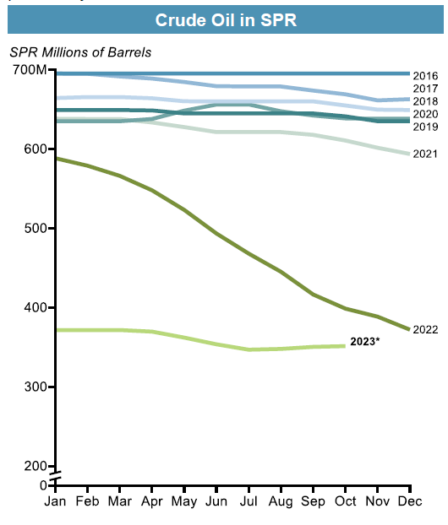
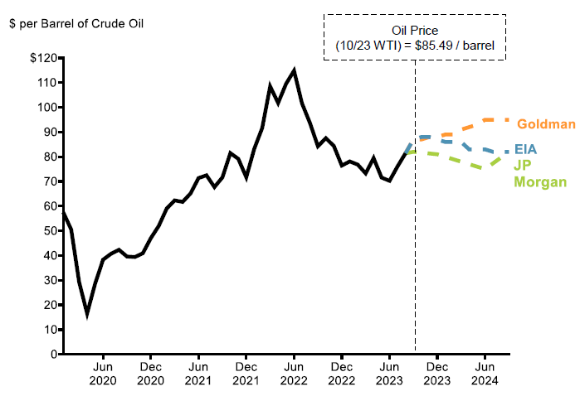
Industry & Market Outlook
Crude Oil in SPR
WTI Oil Price Projections
Key Commentary
OPEC+ managing oil prices
U.S strategic petroleum reserve levels at historic lows
Effective floor mechanism to support oil prices in near-terms
Sources: Market Watch; EIA; Goldman Sachs; JP Morgan; Business Insider.
Note: Historical data updated through August 2023

Slide 6
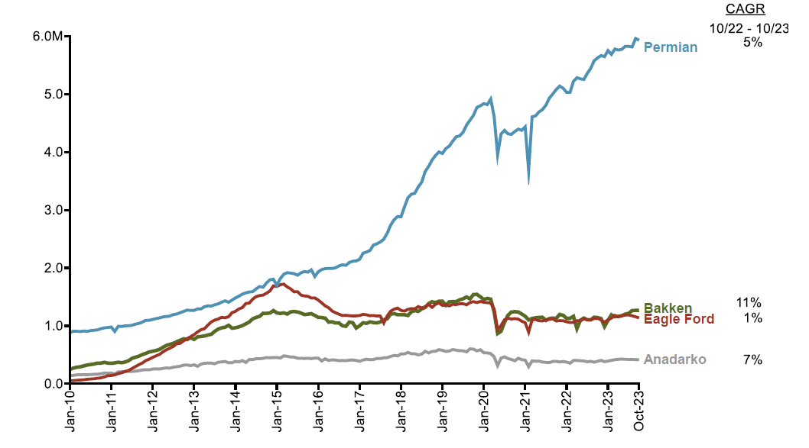
Bakken in Perspective
WTI Oil Price Projections
Key Commentary
Permian producing roughly 5x the Bakken
Cost of transportation and infrastructure a major factor
ND must remain highly competitive (tax, regulatory, labor) to attract capital
Prime opportunity to differentiate ND w/ technology & talent development
Sources: EIA

Slide 7
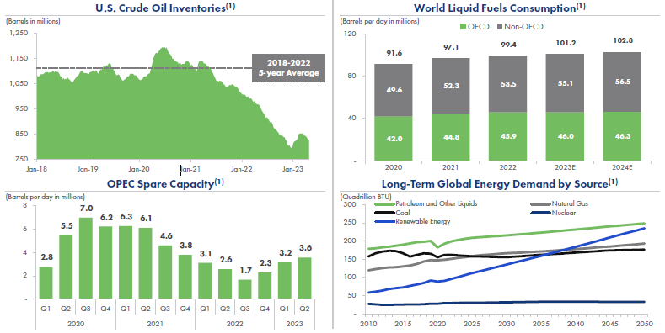
Industry & Market Outlook
Global O&G Supply is Limited…
…With Demand Expected to Grow
Key Commentary
Global O&G demand is expected to continue to outpace supply despite recessionary fears & geopolitical turbulence
10-year lows on US crude inventories
OPEC spare capacity remaining limited
Sources: [EIA]

Slide 8
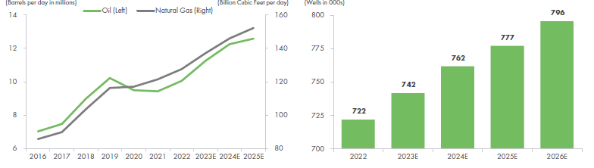
Future Production & Growth
Global O&G Supply is Limited…
…With Demand Expected to Grow
Key Commentary
US O&G production expected to grow because of strong global demand
Stabilized commodity prices, with the number of producing wells expected to expand through 2026
There are approximately 740,000 producing oil and gas wells in the onshore U.S.
The U.S. onshore producing well count is expected to grow by more than 50,000 wells over the next three years
As the number of producing wells expands to grow production, the demand for workforce and innovation will continue to grow
Sources: [EIA]
Notes:
Its worth noting that these projections are worth paying attention to, as two of the largest oil companies in the US completed the largest acquisitions in over 2 decades, Exxon Mobile acquired Pioneer for estimate 60B and Chevron acquired Hess for ~$53M. This should tell you everything you need to know about whether oil and gas will be powerful industry in 2035

Slide 9
Major Questions Considered
How will the industry look different?
What type of skills, degrees, and jobs be in highest demand?
How will students consume education (when, where, how)?
How can we effectively navigate industry perception from society, students, and parents?
What types of market, technology, and demographic disruptions must we consider?
In 2035, what will be the energy industry’s need for a skilled workforce and how will the NDUS be poised to meet those needs?
Notes:
How will the industry look differently over the course of the next 10 years?
Macro outlook trends indicate steady growth for liquid fuels
Industry will continue to innovate, developing new technologies to increase production in Tier I, II, & III assets
Enhanced oil recovery (i.e. CO2) will play a major role in extending the life of the Bakken and its estimated ultimate recover (EUR)
Technology will evolve dramatically in the areas of automation, communications fiberoptics and networks), digitization, and artificial intelligence (AI) (perhaps too soon). Grand Energy?
Advent of major plant operations (petro-chemical, biofuels, etc) will create a new class of industry and requisite workforce
What does the future of alternative energy sources look like (coal, hydro, wind, hydrogen, etc)?
What type of skills, degrees, and jobs be in highest demand?
Hard skills/degrees: Data analytics, communication & networking, distributive control, engineering, financial literacy, AI utilization, trades (welding, plumbing, electrical), robotics, automation, cybersecurity
Soft skills: Communication, teamwork, emotional intelligence (changing the perception of an oil worker)
High-demand jobs: trades (invest in an industrial/trade skill center), engineers, network & automation technicians, plant operators, data analysts
What is needed for alternative energy sources?
How will students consume education (when, where, how)?
Invest in innovated scholarship programs like the 2023 Re-Energize bill or forgivable loans for graduating students who stay in the state for a specified period of time
We must meet prospective students (energy workforce) where they are at and provide the right balance online access and in-person, hands on education
We must have a plan to retrain existing workforce to adapt to a more technologically advanced industry (data, robotics, automation, network communications)
We must think outside of the box and develop a marketing strategy for untapped demographics
More aggressively market to western ND high school students
Identify and market to the “forgotten middle” in major, metropolitan cities such as Houston, Chicago, and Shreveport)
Investigate and utilize visa programs such as U4U and recruitment strategies used by other industries from countries like the Philippines and Puerto Rico
How can we effectively navigate industry perception from society, students, and parents?
Coalesce industry leaders (from ND) to get in the classroom (middle school, high school, colleges). Pool resources from industry and NDUS to formalize an outreach program
Invest in marketing programs and recruiters that educate the public on the significance of the energy industry on our state, region, and country
What is the future of program’s directly tied to petroleum vs programs provided skills and training that can be utilized by the energy industry?
What types of market, technology, and demographic disruptions must we consider?
Public and financial institutions’ perception of the liquid and gas fuel industry
Global conflicts driving uncertainty in supply
OPEC’s re-established eminence over the oil markets
Growing global population and demand for energy
Advancements in EOR technology, specifically CO2 transportation, sequestration, and utilization

Slide 10
Workforce Recruitment & Development
Cultivating our existing labor pools and creating sourcing net-new talent

Slide 11
Workforce Recruitment
Renewed focus on “keeping our own”
Ensure ALL K-12 students know what is available throughout the entire state and educate “influencers”
Outreach to retiring military & younger veterans who have completed their initial service obligation. Highlight ND military friendly state policies
Invest in marketing, recruiting, and outreach efforts to education in rural and major cities in ND.
Net new in-migration: “Grow the labor pool, can’t solve the math problem on our own”
Think creatively about recruiting out of state students through a focus on partnerships with large k12 metro districts (scholarship)
Explore expanding partnerships with ND Energy employers for internships/sponsorships
Utilize the talents active, guard, reserve, & retired military through promotion of competitive tax policy
Study opportunities to tap legal immigrants through existing visa programs (Ukraine, Philippines, Puerto Rico)
Support legislation that incentives attraction, retention, & development of talent
Notes:
First and foremost, we can have all the programs in the world, but if we don’t do a better job of growing the pie (the labor pie), meaning if we don’t find creative ways to attract new North Dakotan’s, the investment is all for not.
What we learned is that we have many wonderful programs, that are in fact in high demand by employers, but we don’t have students to fill them.
How do we promote our tax policy for retiring military as tool to retain them in ND
Tax policy and creative student loan solutions should be a significant consideration in the next legislative session in terms of how we retain and recruit
- Forgivable loan programs for students who attend NDUS institutions and stay and work in ND for a period of time

Slide 12
Curriculums & Programs
Collaborating with industry and key stakeholders to accelerate adaptation to workforce demands

Slide 13
Curriculums & Programs
Technology in the industry is rapidly evolving, such as automation & robotics (Grand Energy)
Will drive demand for skills cyber security, computer science, I&E, engineering, and data analytics (grand opportunity)
Research in these fields presents a unique opportunity for collaboration with industry
O&G production growth will require greater capacity for skilled trades
Expand industrial skill/trade centers & create intentional partnerships w/ industry to understand needs
Future gas processing and petrochemical industry development
Will require expansion of programs in plant operations and major infrastructure projects (CO2 sequestration & utilization)
Flexibility & adaptability ➔ must meets students where they are
Improve dialogue between industry and academia to understand need of non-traditional students & opportunities to re-train and upskill the energy workforce
Promote opportunities for stackable certificates and degrees (2+2)
Notes:
Don’t forget the soft skills!

Slide 14
K-12 Engagement
Deeping cooperation w/ K-12 to educate and enhance accessibility to energy career tracks

Slide 15
Engage ND K-12 Schools
Connect higher ed and industry to career counselors in K-12, support greater investment into career counseling, & promote middle school CTE career exploration
Enhance CTE availability for all K-12 ND students, with energy career tracks identified (i.e. career academies, CTE, REA, vo-tech, Train ND, and certificates
Develop intentional and organized marketing campaigns to students and families about the industry (are we doing everything we can?)
Create industry driven curriculum model/schematic (12-22) that synthesizes all avenues to a career in O&G.
Explore Modular Technology Education (MTE) to improve accessibility to rural communities
Improve dual credit accessibility & leverage to direct students to the energy industry
Notes:
CTE and NDUS are separate budgets, but a significant part of the skill demand in ND’s energy industry can be fulfilled with CTE. NDUS should “double down” on CTS and discuss how to foster this relationship with deeper connection and integration for the great good.
Enhanced support for CTE would make a meaningful impact on their ability to supply needed training for the workforce – again, this is the differentiator for ND vs the rest of the country

Slide 16
Diverse Energy Sources
Hydrogen: Heartland Hydrogen Hub selected for US DOE $925M funding
Collaborative initiative that will produce low-carbon hydrogen, decarbonize regional supply chains, and create clean energy jobs
Aims to reduce CO2 emissions by integrating technologically diverse clean hydrogen projects in multiple sectors such as agriculture and industrial manufacturing
Coal: Continued utilization of clean coal in ND for baseload electrification
How can clean coal technologies extend the life of the coal industry
Wind & Solar: National projections show solar and wind growing
Will require technicians to build new and repair existing infrastructure

